Slide 1
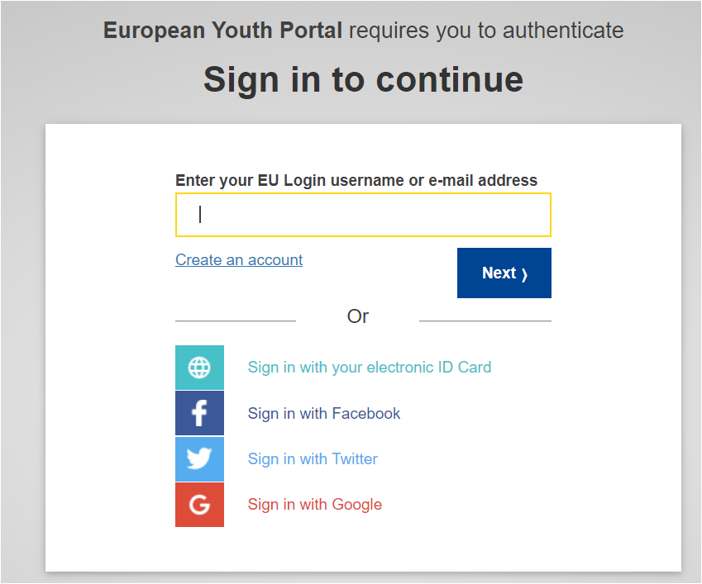
Event organisers – how to submit an event
Use the “Submit your event” button in the EWoS 2023 website (will be available during August / exact date to be communicated).
Or
Access directly the url: https://youth.europa.eu/d8/admin/ews
You will be asked to login via EU Login, to the European Youth Portal (EYP – https://youth.europa.eu)
If you have already an EU Login account, you can enter your email and password. If you use EU Login frequently your username/ email will be prefilled, and you will have just to enter your password.
If not, you can create an EU Login account using the “Create an account” option and your email address. Social media authentication can also be used.

Slide 2
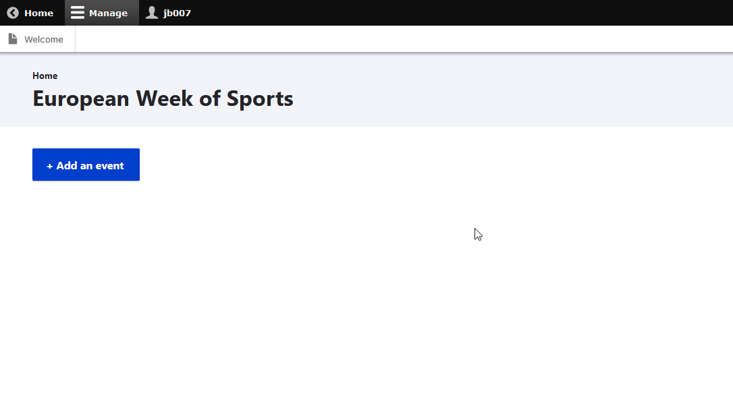
Event organisers – how to submit an event
After successful authentication with EU Login, you will be redirected to the European Week of Sports section
Click on “+Add an event” button to trigger the creation of a new event.
Useful info:
If you have already submitted events, they will appear in this list
If you have already logged in to submit an event one time, you can also use the “Administrator login” option, in EYP (https://youth.europa.eu) ’s footer, to login

Slide 3
Event organisers – how to submit an event
 | Field | Mandatory | Type | Possible values | Comments
1 | Title | Yes | Free text | Not applicable - n/a | Max 100 chars
2 | Description | Yes | Free text | n/a | Max 200 chars
3 | Start date / time | Yes | Date/time | n/a | Time to be entered in local time zone
4 | End date / time | Yes | Date/time | n/a | Time to be entered in local time zone
5 | Organised by | Yes | Free text | n/a | Max 100 chars
 | Location |  | Complex field |  | For details on how it works, the UI should be taken into account
6 | Venue name | No | Free text | n/a | Max 100 chars
7 | Address | No | Free text | n/a | Max 100 chars
8 | Postal code | No | Free text | n/a | Max 10 chars
9 | City | No | Free text | n/a | Max 50 chars
10 | Region | No | Free text | n/a | Max 50 chars
11 | County | Yes | List / Single select | Countries list
12 | Geocode (coordinates) | Yes | Special field | n/a | n/a
13 | Event Type | Yes | List / Single value | Special list: Education Home Workplace Outdoors Sport and fitness clubs Other | Single value field
14 | Link | No | Free text | n/a | url syntax validation
Fill in the event form fields and “Save” your event
Fields to fill in →
The process is still under development, and there can be minor differences in the last version

Slide 4
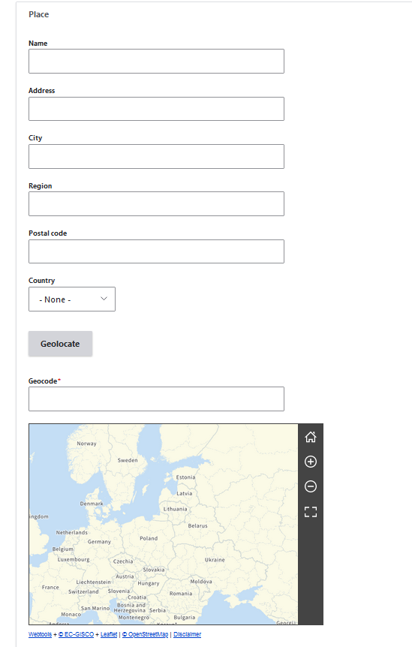
Event organisers – how to submit an event
Since a map will be the final destination of any event, it is very important to have the correct location for it.
The form helps you getting the correct coordinates for your event:
Enter the address of the event (in the fields “Address” , “City” , “Region”, “Postal code” , “Country”). You can optionally have a name for the venue – if applicable. Region is not used in the geo-location, you can leave it empty, unless you want to emphasize the region of the event.
Click on the “Geolocate” button.
The EC Geolocation service is used to calculate the coordinates.
If it managed to locate coordinates, you will see a pin on the map in the co-ordinates calculated
If the location is not correct / accurate, you can click on the map and the pin will move to the correct point. At the same time the coordinates are automatically updated.
If the geolocation process fails, you can:
Directly move on the map to the correct place and click on it to place the pin , or
Try to edit / improve the address and click again on “Geolocate”

